Slide 1
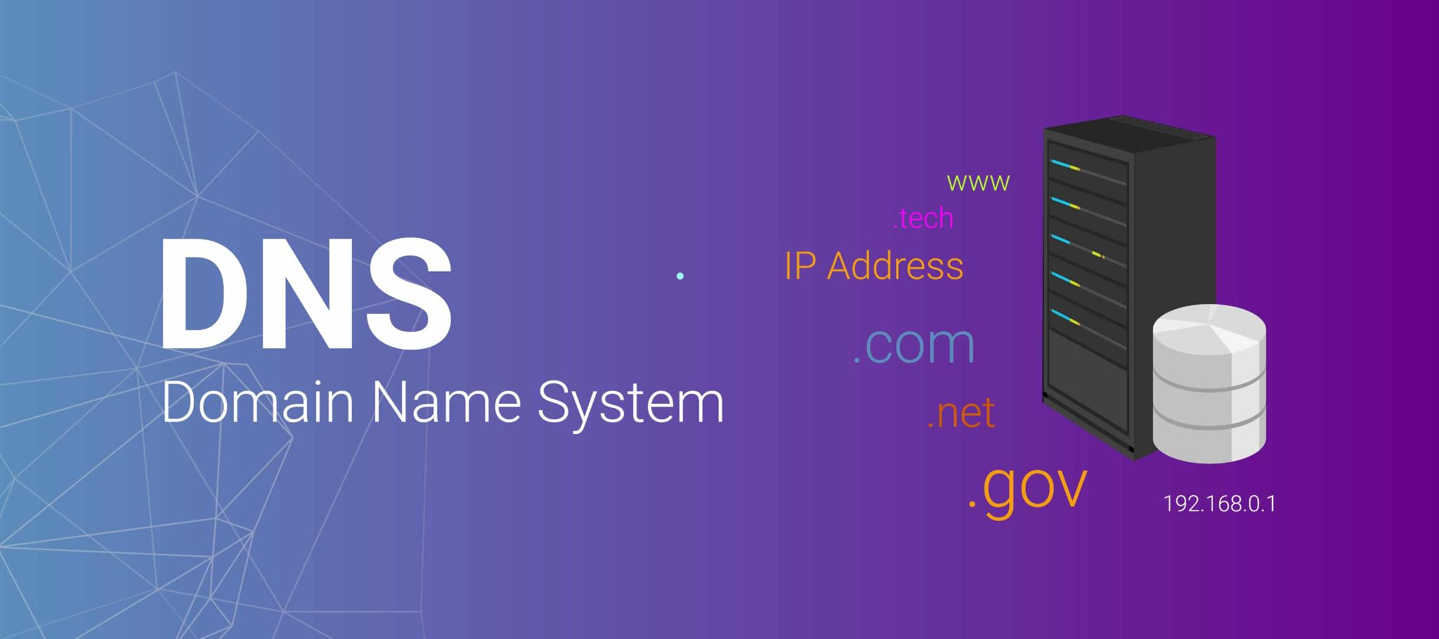
Julien MANTEAU - 2025

Slide 2
Objectives
Describe the principles of the DNS
Describe how the DNS data are handled and organized
Identify the various types of name servers and how a DNS resolution is done
Describe the key DNS operations
Describe the role of DNS in killchain
Identify the malicious usages of DNS

Slide 3





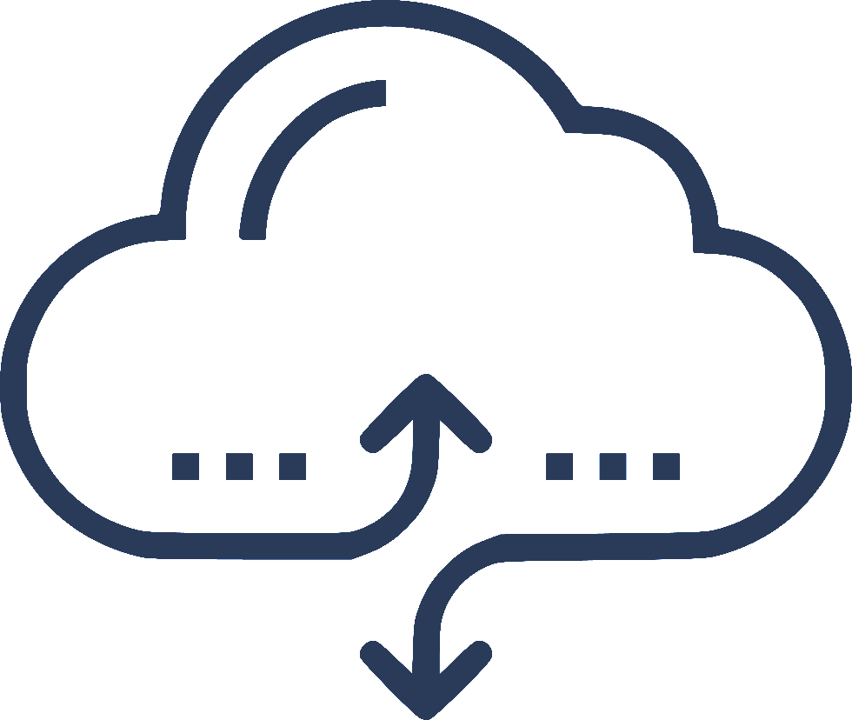






Teacher Presentation: Julien MANTEAU
Network & Telecom Engineer (ENSEEIHT)
Lecturer at Bézier then Blagnac IUT in “Réseaux Télécoms” from 2010 to 2020
Leader on Airbus CyberDiploma cursus setup and teacher/lecturer since 2021
Hobbies:
Systems & Network Security Engineer
LAN Global Technical Leader
Connectivity Solution Architect
2019
France Network Service Delivery Manager
Cloud Solution Architect
Public & Private Cloud Principal Architect

Slide 4
AGENDA
DNS Overview
1
What is the Domain Name System ?
DNS & CyberSecurity
2
How DNS can be subverted ?
Labs
3

Slide 5

DNS Overview

Slide 6

DNS is hard ?
The only three hard problems in computer science are cache invalidation and naming things.
And DNS is a caching system for names of things.
(And off-by-one errors)

Slide 7

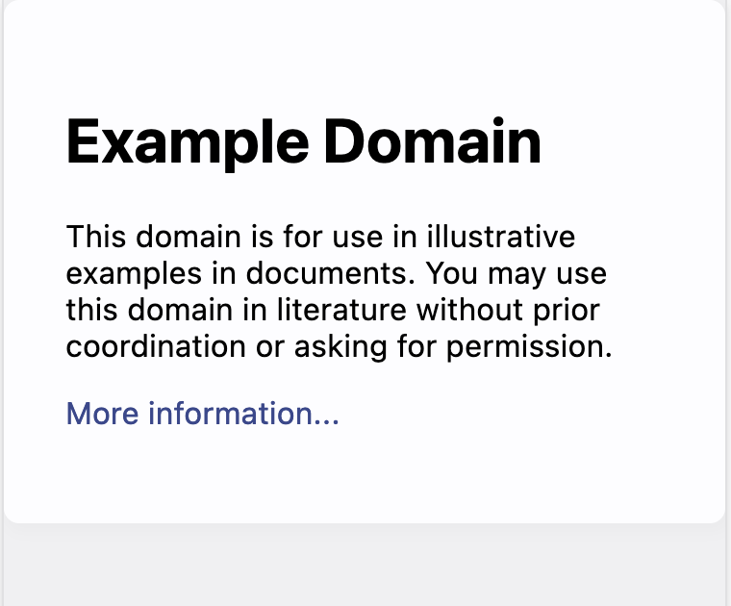
Question
What is happening behind the scenes ?
What do you know about the protocol allowing the name to be translated into technical information ?

Slide 8
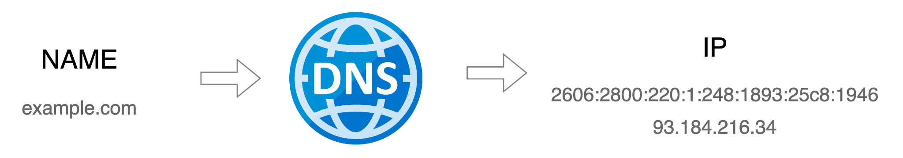
What is DNS ?
DNS is a distributed, hierarchical system for translating objects.
The main usage is Name to IP translation but it can also be IP to Name, Name to Ressources (Mail Servers, Domain Verification, etc)
DNS can mean the system (Domain Name System) or the infrastructure supporting it (Domain Name Servers)
DNS is a critical piece of the Internet infrastructure and any network infrastructure.

Slide 9

DNS Features
Globally Distributed
Multiple DNS servers managed by different operators
Loosely coherent
Even if distributed, servers are still part of one global DNS system
Scalable
The system can be scaled up and multiple servers can be added
Reliable
Failure tolerance due to hierarchical distributed architecture and local caches
Dynamic
Anyone can add domains and records without causing outage

Slide 10
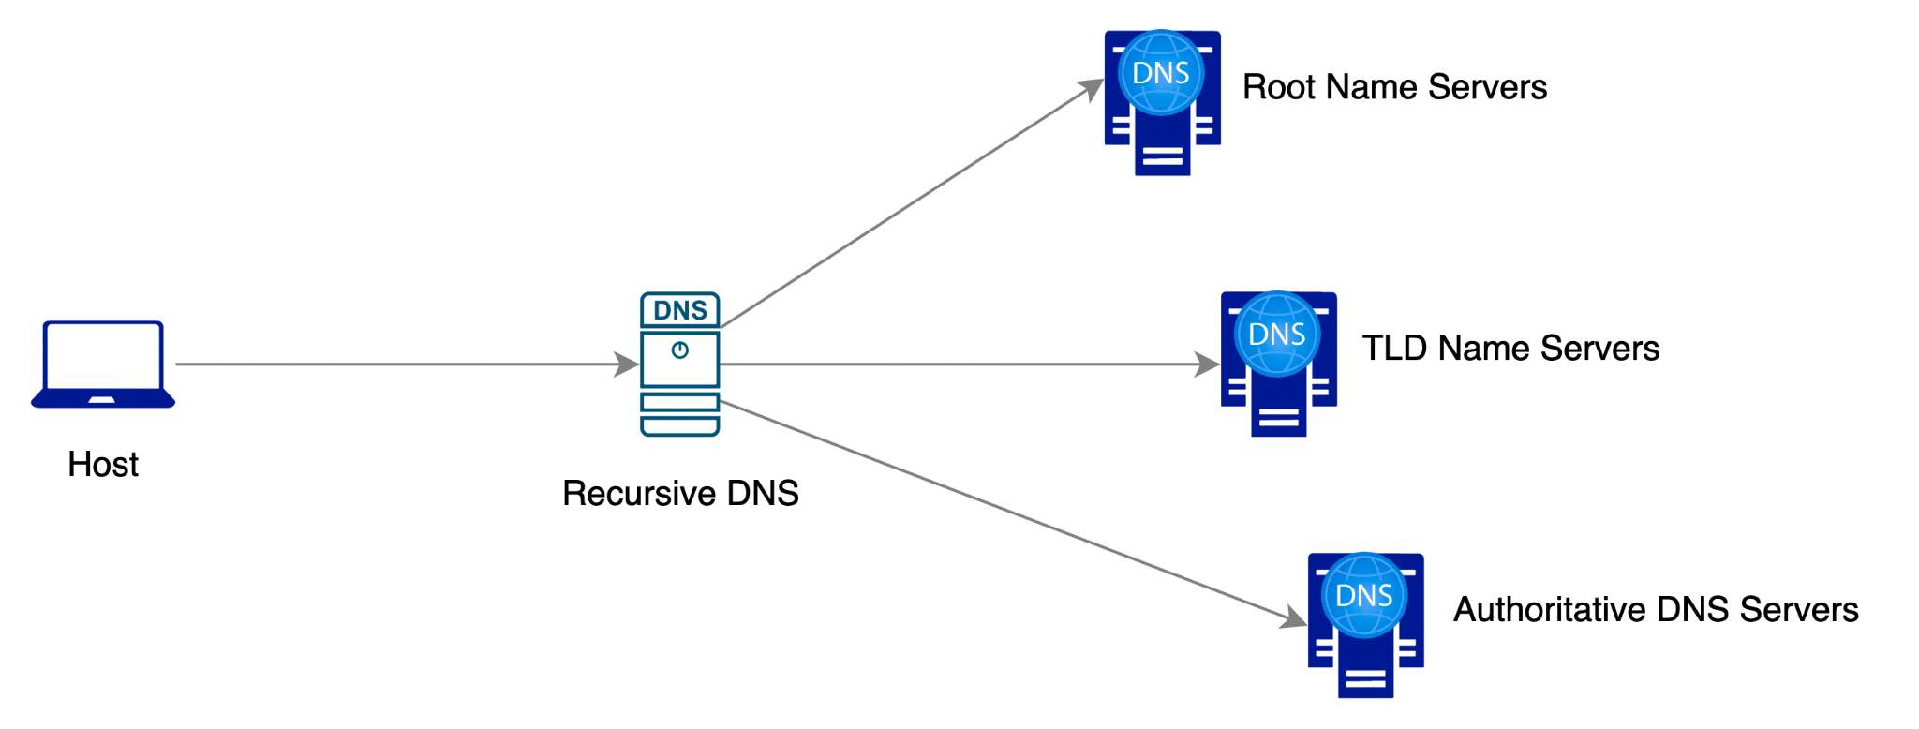
DNS Protocol
DNS is a client-server protocol
  Client (resolvers) requests resolution for a function (IP, mail server …) of a name
  DNS server responds with information about the record
Requests and responses are normally sent via UDP/53
Also uses TCP/53 for large requests
  Ex: Zone transfers, large answers with DNSSEC, etc

Slide 11
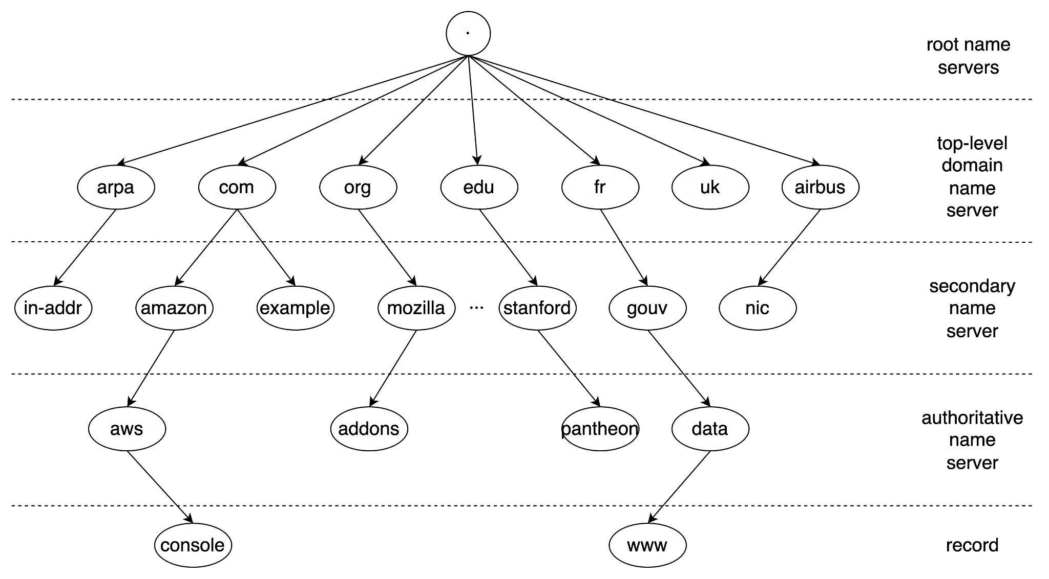
DNS Namespace Hierarchy
13 Anycasted Root Servers (URL)
1446 TLDs
(Oct 2024) (URL)
~360 Millions domains (URL)

Slide 12
Who is responsible for DNS ?
ICANN (Internet Corporation for Assigned Names and Numbers): Oversees the global DNS structure, including the policies governing domain name registration.
IANA (Internet Assigned Numbers Authority): Part of ICANN, IANA coordinates key technical aspects of DNS, including the root zone file. It assigns IP address blocks, manages root servers, and designates top-level domains (TLDs).
Registry Operators: Responsible for specific TLDs (like Verisign for .com), they maintain the records of domains under each TLD.
Registrars: Accredited companies (e.g., GoDaddy) that allow individuals and organizations to register domain names.
ISPs and Network Admins: Provide local DNS servers, translating domain names to IP addresses for end-users.

Slide 13
country-code top-level domains (ccTLD)
internationalized country code top-level domains (IDN ccTLD)
generic top-level domains (gTLD)
Special-Use top-level domain
sponsored top-level domains (sTLD)
unsponsored top-level domains
IANA type of TLDs
01
Two-character domains established for countries or territories. Example: .us for United States. .ca, .uk, .ae, and .fr are all ccTLDs.
ccTLDs in non-Latin character sets (e.g., Arabic or Chinese).
Top-level domains with three or more characters which include the generic .com, .net, .gov, .org, and more.
These domains are proposed and sponsored by private organizations that decide whether an applicant is eligible to use the TLD, based on community theme concepts. Include .airbus, .museum, .travel, etc
Domains that operate directly under policies established by ICANN processes for the global Internet community, for example "edu".
This group consists of Address and Routing Parameter Area (ARPA), Private TLD (corp, local, etc) or specific TLD such as TOR .onion

Slide 14
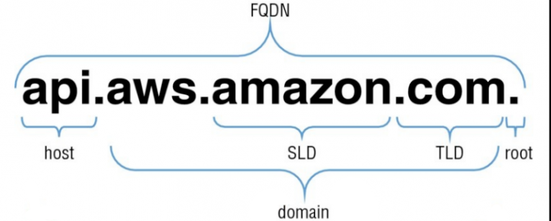
DNS Terminology: “name” decomposition
A Fully Qualified Domain Name is an absolute name containing the host and the domain. A proper FQDN ends with a dot, indicating the root of the DNS hierarchy.
Root domain is the highest domain : “.”
second level domain:
Host refer to separate computers or services accessible under a domain
top-level domain is the most general part of the domain
The domain part of a FQDN. This is usually the part that needs to be loaned/registered to be used
Notes:
Root domain is the highest domain : “.”
A top-level domain, or TLD, is the most general part of the domain. The top-level domain is the furthest portion to the right (as separated by a dot)
A “subdomain” refers to any domain that is part of a larger domain. In this case, “amazon.com” can be said to be a subdomain of “com”. This is typically just called the domain or the “amazon” portion is called a SLD, which means second level domain. DNS works in a hierarchy. Each domain can control “subdomains” that are located under it. This is usually what we mean by subdomains. The difference between a host name and a subdomain is that a host defines a computer or resource, while a subdomain extends the parent domain. It is a method of subdividing the domain itself.
Within a domain, the domain owner can define individual hosts, which refer to separate computers or services accessible under a domain
A Fully Qualified Domain Name is an absolute name that specifies its location in relation to the absolute root of the domain name system. This means that it specifies each parent domain including the TLD. A proper FQDN ends with a dot, indicating the root of the DNS hierarchy.

Slide 15
Types of DNS Record
They are 47 active DNS types and 43 obsoleted ones. (List here). The most common are:
A
AAAA
Links the hostname to the IP address. (A: IPv4, AAAA: IPv6)
identify the Start of Authority with essential parameters of the zone (NS, contact info, default TTLs)
SOA
CNAME
Point a Domain Name to another Domain Name
NS
NameServer records identify the responsible DNS Server for answering this zone.
TXT
Text records are used to store descriptive text (site verification, SPF/DMARC mail record, etc)
PTR
Pointer record links an IP address to a domain name (opposite to A)
MX
Mail Exchanger record point the domain name of the email server responsible for the domain name.
SRV
SeRVice record points to a host and its corresponding port for a specific service with a priority. It is used for discovering a services.
CAA, LOC, HINFO, RRSIG, NSEC, DNSKEY, GLUE are also seen but are more “advanced ones”

Slide 16

Quizz Time
www.pollev.com/jmanteau973

Slide 17

DNS Client: nslookup/dig
nslookup is officially deprecated in favour of dig.
nslookup is however almost universally available (e.g. only resolver on Windows).
So my recommendation is:
Master and have dig on your system for dns investigation and testing.
Know enough nslookup for basic troubleshooting on others devices
Practical Exercise: Request DNS with Dig

Slide 18
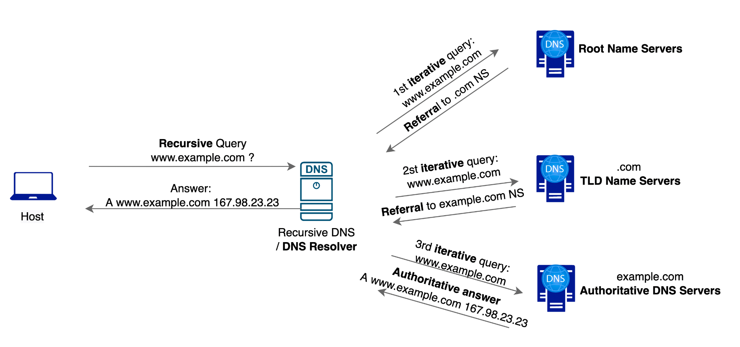
Full DNS Query and types of DNS Server
Notes:
A Recursive DNS resolver responds to a recursive request from a client and takes the time to track down the DNS record (like a librarian fetching a book for a client querying it with its identifier)
Root nameserver is the first step in translating (resolving) human readable host names into IP addresses. It can be thought of like an index in a library that points to a room with different racks of books.
TLD nameserver can be thought of as finding a specific rack of books in a library. This nameserver is the next step in the search for a specific IP address.
Authoritative nameserver - This final nameserver can be thought of as a dictionary on a rack of books, in which a specific name can be translated into its definition. The authoritative nameserver is the last stop in the nameserver query. If the authoritative name server has access to the requested record, it will return the IP address for the requested hostname back to the DNS Recursor (the librarian) that made the initial request.

Slide 19
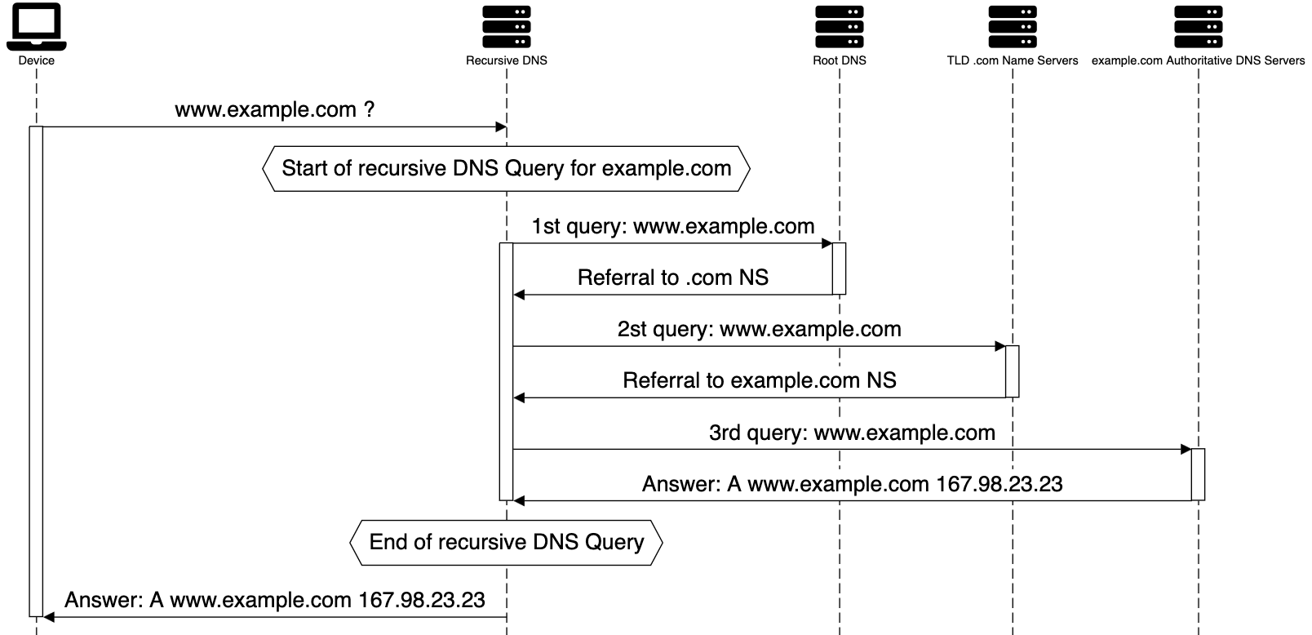
Full DNS Query

Slide 20
Lab: Full DNS Query sequence diagram for www.impots.gouv.fr
Practical Exercise: Full DNS Query
Based on the previous sequence diagram (click on link), please recreate the full chain of the resolution of www.impots.gouv.fr
❯ dig www.impots.gouv.fr +noall +answer
www.impots.gouv.fr. 129 IN CNAME www.impots.gouv.fr.edgesuite.net.
www.impots.gouv.fr.edgesuite.net. 21429 IN CNAME a1352.dscb.akamai.net.
a1352.dscb.akamai.net. 20 IN A 95.100.133.81
a1352.dscb.akamai.net. 20 IN A 95.100.133.74

Slide 21
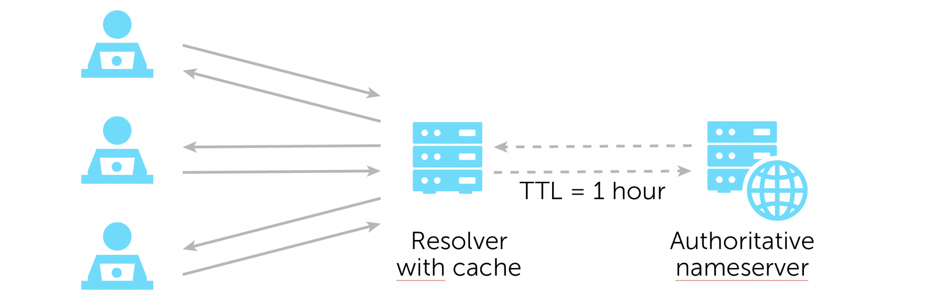
TTL: Definition
TTL (Time To Live) is a value configured on the DNS Server which informs the client / resolver how long it should store the DNS record details before sending the query to get the updated information. The DNS Server returns the TTL Value along the record.
Per the DNS RFC, DNS TTL values can be configured from 0 seconds to 248555 days.
However DNS client implementations can have different values.
This is why I personally advise TTL values between 1min and 1 day.
Notes:
A or AAAA Record: Your A records should be set to a faster pace TTL as IP address lookups can change frequently if usage of CDN. A standard baseline would be around the 1-hour mark but may need to be adjusted depending on how often changes need to be made on an emergency basis (30 seconds in case of rapid change).
CNAME Record: Your main website URL, for example (www.example.com), should usually never change. It is recommended that you set your TTL for something longer than the average session time (for example 10 min).
TXT Record: Widely used for DKIM records, email security and verifying domain ownership. TXT records are rarely changed so anywhere within the 1 – 12-hour timeframe should suffice.
MX Record: Your mail exchange TTL can be set between the 12-24 hour range, but you may want to consider placing it lower in case of emergencies; somewhere in the 1-4 hour range would be useful as well.

Slide 22
​​
DNS Cache
DNS Cache (sometimes called a DNS resolver cache) is a temporary database, maintained by an OS, that contains records of all recent DNS lookups.
Before attempting to resolve a name, the OS will check if the entry is present in the cache. The entries are cleared according to their TTL. Before requesting he will also check the “static cache”: the hosts file.
A browser will also have a DNS cache that they will use before using the OS cache (and the default resolver if not in OS cache OR their own resolver)
 | Windows | Linux (if present) | Mac (12.x) | Chrome | Firefox
Check Cache | ipconfig /displaydns | resolvectl query $HOSTNAME | Hashed as considered as private data | chrome://net-internals/#dns | about:networking#dns
Clear Cache | ipconfig /flushdns | resolvectl flush-caches | sudo dscacheutil -flushcache; sudo killall -HUP mDNSResponder
Notes:
A or AAAA Record: Your A records should be set to a faster pace TTL as IP address lookups can change frequently if usage of CDN. A standard baseline would be around the 1-hour mark but may need to be adjusted depending on how often changes need to be made on an emergency basis (30 seconds in case of rapid change).
CNAME Record: Your main website URL, for example (www.example.com), should usually never change. It is recommended that you set your TTL for something longer than the average session time (for example 10 min).
TXT Record: Widely used for DKIM records, email security and verifying domain ownership. TXT records are rarely changed so anywhere within the 1 – 12-hour timeframe should suffice.
MX Record: Your mail exchange TTL can be set between the 12-24 hour range, but you may want to consider placing it lower in case of emergencies; somewhere in the 1-4 hour range would be useful as well.

Slide 23
TTL: Lookup
ISP DNS Resolver Local TTL
❯ dig wikipedia.org +noall +answer
wikipedia.org. 403 IN A 185.15.58.224
❯ dig ns wikipedia.org +noall +answer
wikipedia.org. 2907 IN NS ns0.wikimedia.org.
wikipedia.org. 2907 IN NS ns2.wikimedia.org.
wikipedia.org. 2907 IN NS ns1.wikimedia.org.
❯ dig wikipedia.org +norecurse @ns0.wikimedia.org +noall +answer
wikipedia.org. 600 IN A 185.15.58.224
Locate and direct
Query to authoritative
NS
Authoritative TTL answer
If your default DNS server is not the authoritative server for the zone you are digging (so 99,99% of the time) dig will show the time remaining (until the next refresh) instead of the raw TTL value in this position.

Slide 24
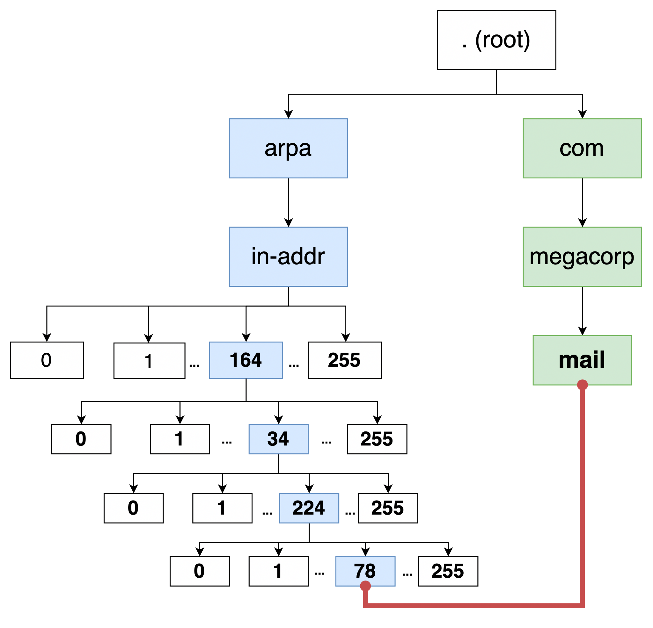
DNS Concepts: Reverse Mapping / DNS Lookup, PTR Record
78.224.34.164.in-addr.arpa PTR mail.megacorp.com
This is equal to :
"Pointer from IP 164.34.224.78 to mail.megacorp.com"

Slide 25
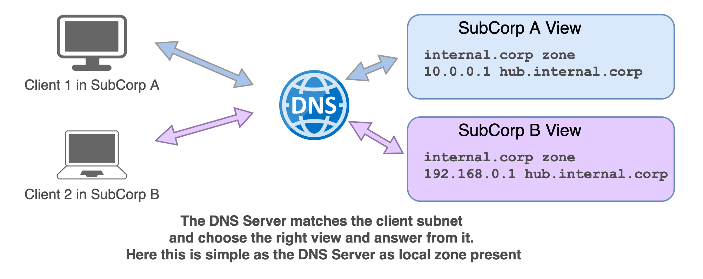
DNS Concepts: Views

Slide 26
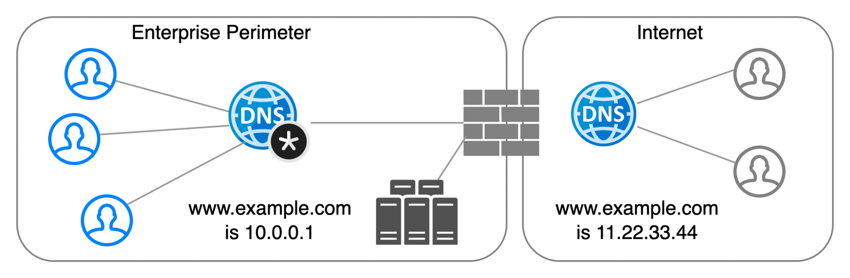
DNS Concepts: Split Horizon
Split Horizon is the DNS concept that the same resource is having different DNS entry depending from where the resolution is done. It can be implemented in different ways:
DNS Views
Different DNS servers (hence different zones)
DNS Global Load Balancing
RPZ

Slide 27
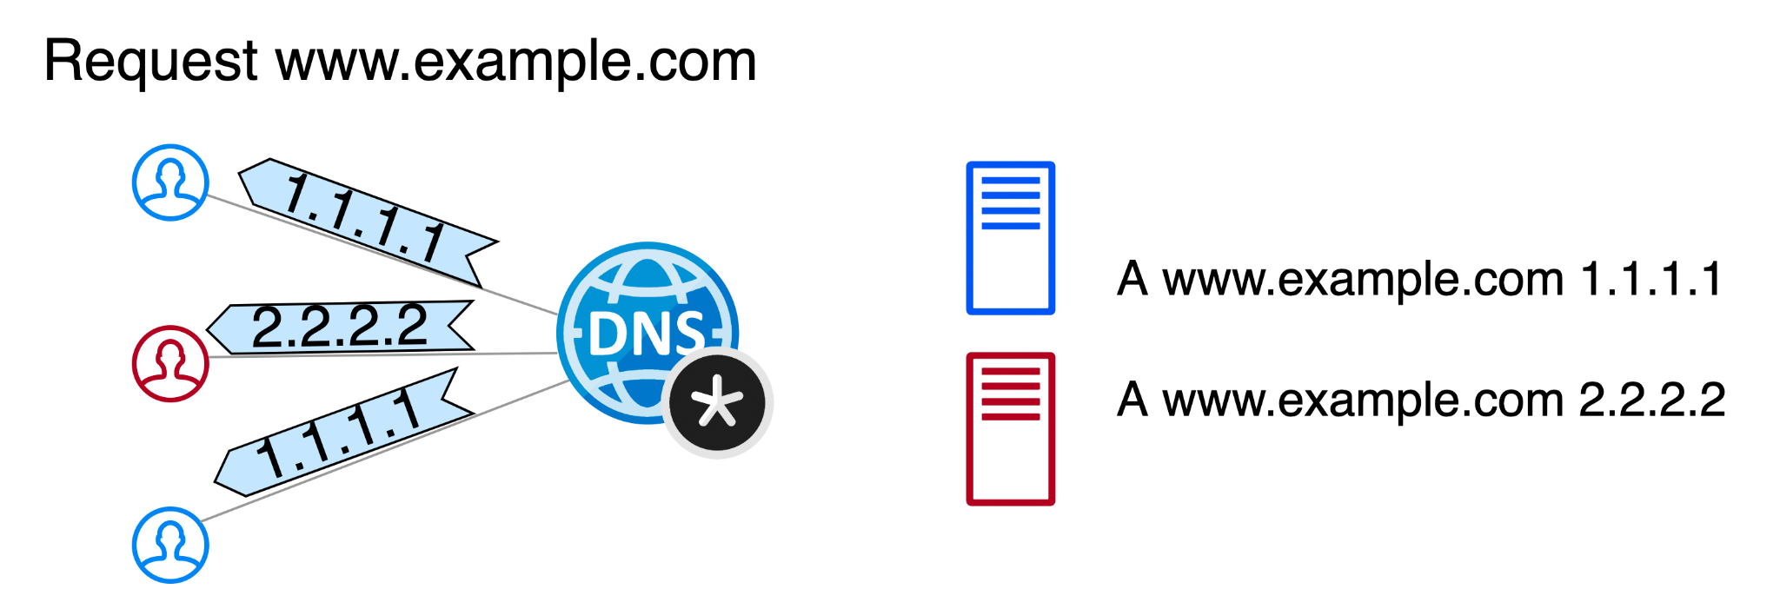
DNS Concepts: Round Robin
What it is: A DNS load balancing method managed by the authoritative nameserver, without needing dedicated load-balancing hardware.
Use Cases: Ideal for websites or services hosted on multiple redundant servers or when a single DNS name directs to multiple proxy servers.
How it works: The nameserver provides a different IP address in each DNS response, rotating through available server IPs for balanced traffic distribution.

Slide 28
DNS Concepts: RPZ definition
DNS Response Policy Zone (RPZ) is a DNS zone which allow to customize policy in DNS servers, so that the server returns modified answers to clients’ queries.
RPZ provides a way to alter a DNS response in real time. RPZ is a “lying” mechanism.
It can be used to modify potentially unsafe DNS Data to block communication or provide local data to redirect to a “walled garden”.
As we can alter query response or block any domain using RPZ it is also known as DNS firewall (or DNS Sinkhole).

Slide 29
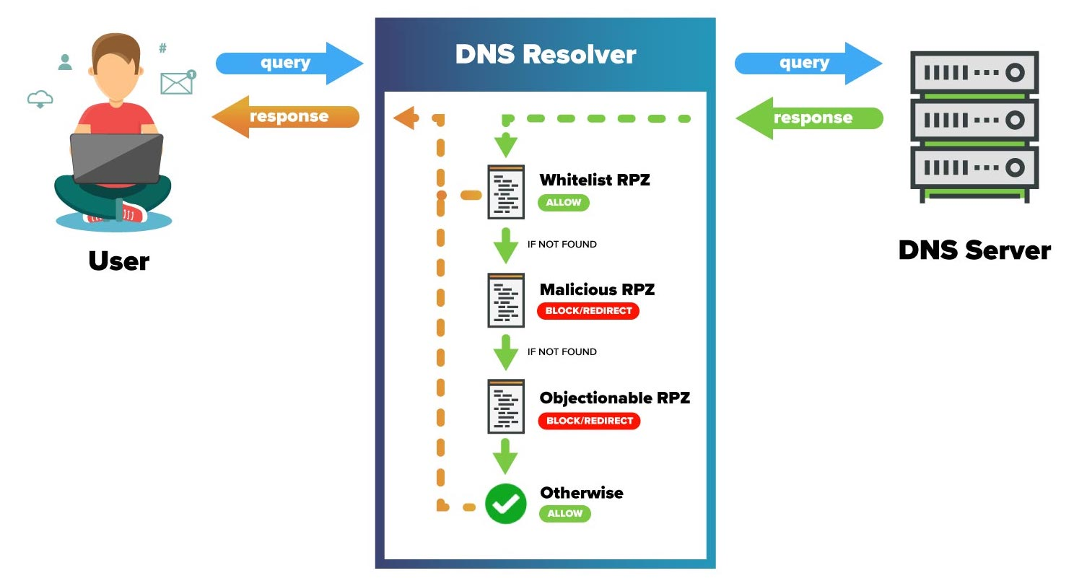
DNS Concepts: RPZ schema

Slide 30
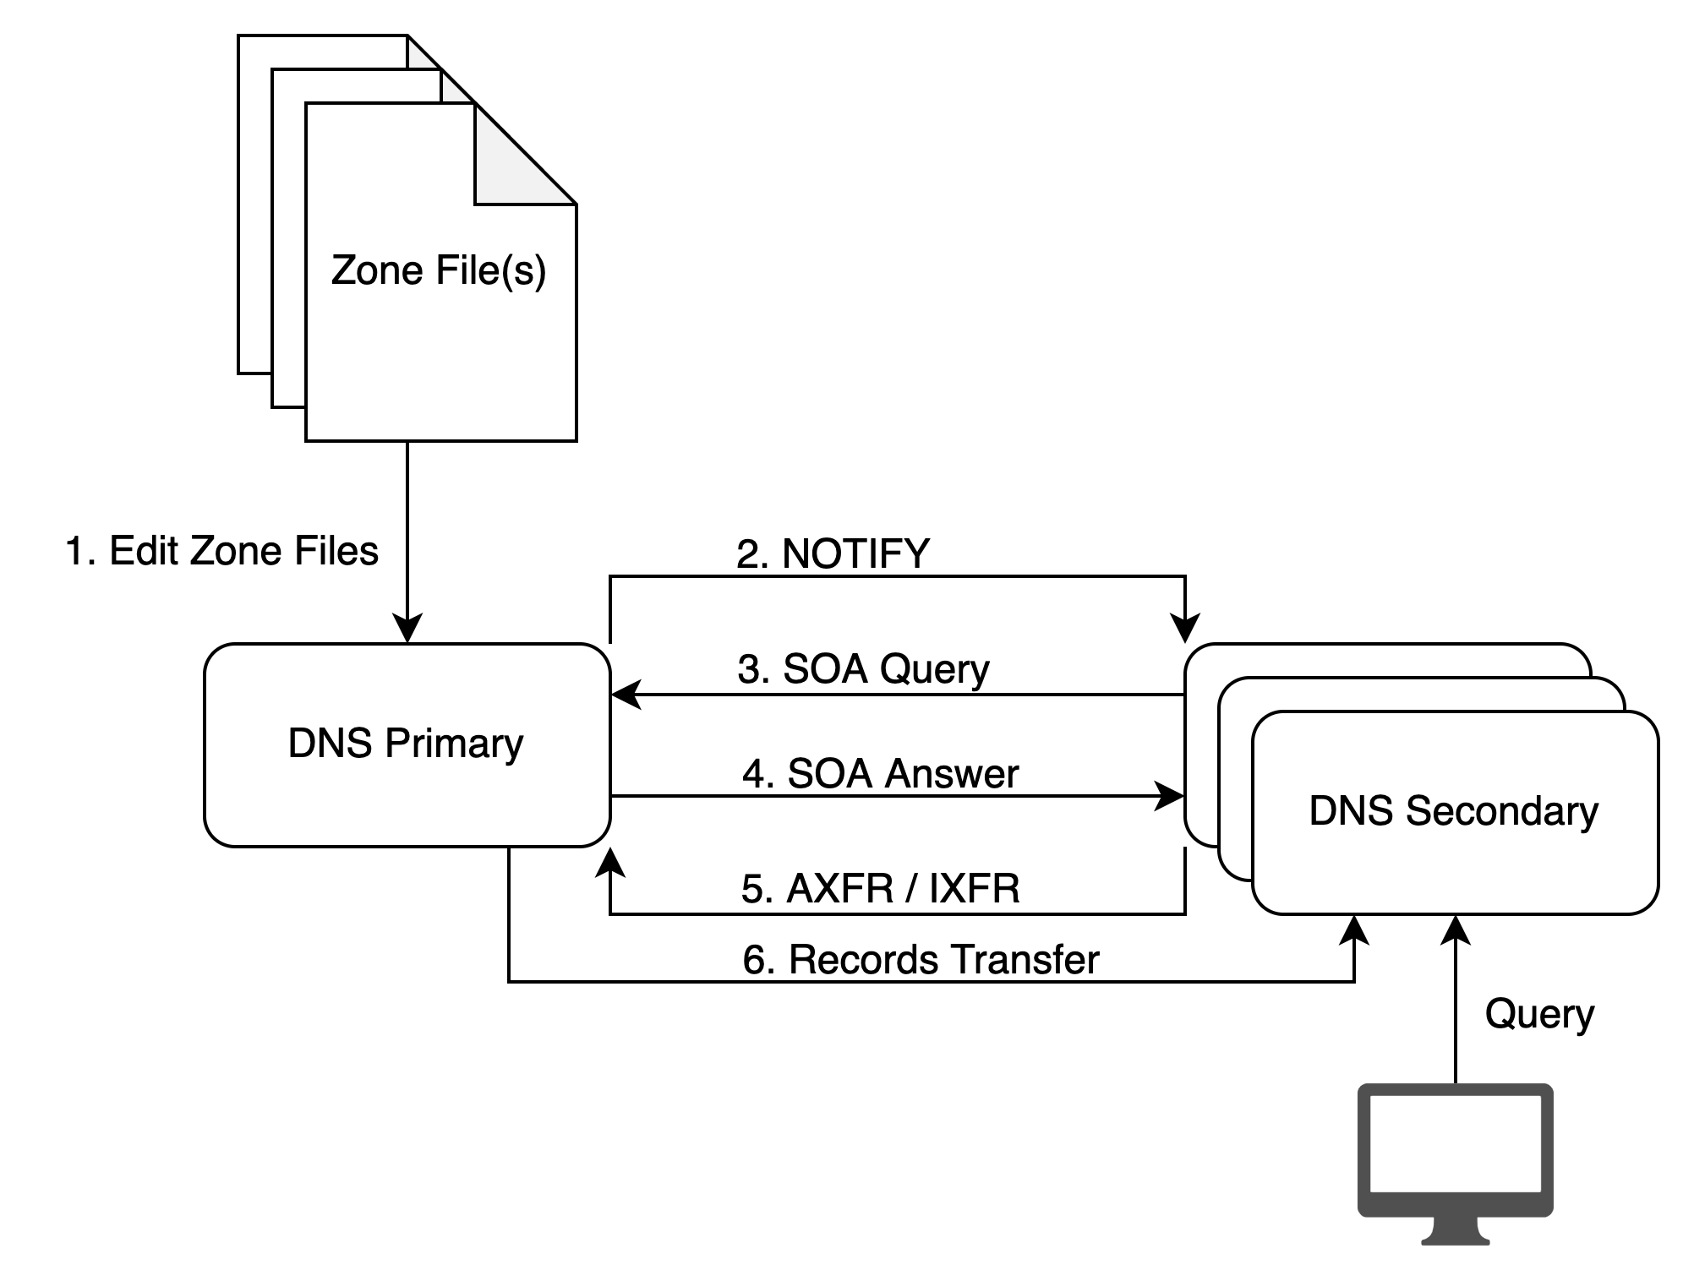
DNS Concepts: Primary, Secondary & Zone Update
DNS Zone Primary / Secondary (used to be called Master / Slave) is a concept which allow DNS servers to scale while keeping one unique management point for zone edition.
The master contains the DNS data source of truth.
Secondary reads Master SOA Resource Record, check the serial number and request zone transfer if higher
It is impossible to determine from a query result that it came from a zone primary or secondary.

Slide 31
Quizz Time
www.pollev.com/jmanteau973

Slide 32

DNS & CyberSecurity

Slide 33









How DNS is used by malware (DNS usage in the KillChain) ?
DNS Protocol Anomalies
DNS Exploits
DNS Hijacking
DNS Resolution
DNS Callback
DNS Tunneling
Weaponization
Exploitation
Command & Control (C2)
Coupling exploit with backdoor into deliverable payload
Exploiting a vulnerability to execute code on victim’s system
Command channel for remote manipulation of victim
2
4
6
1
3
5
7
Reconnaissance
Delivery
Installation
Actions on Objectives
Harvesting email addresses, conference information, etc.
Delivering weaponized bundle to the victim via email, web, USB, etc.
Installing malware on the asset
With “Hands on Keyboard” access, intruders accomplish their original goal
DNS Resolution
DNS Infiltration
DNS Tunneling
DNS Exfiltration
DNS DDoS
DNS Reconnaissance

Slide 34
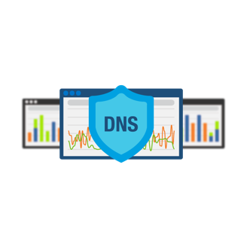



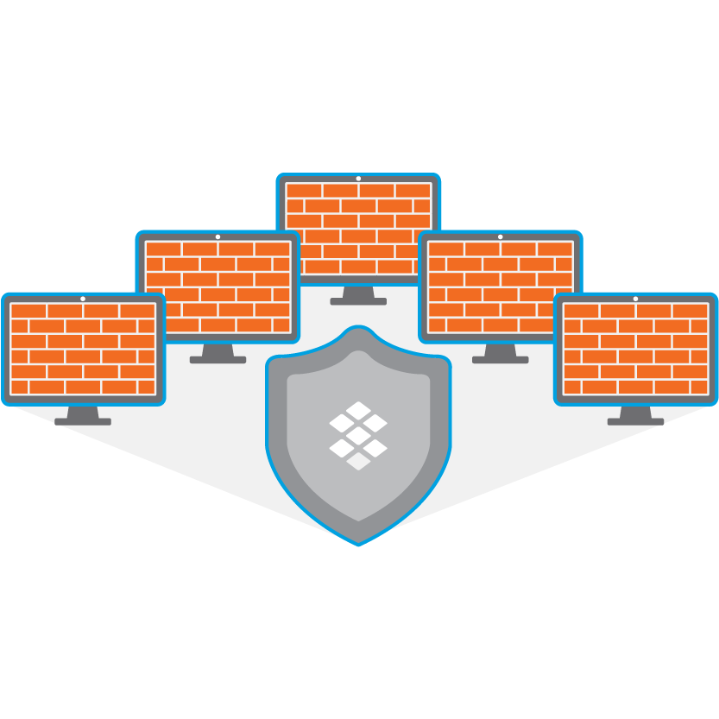
DNS & CyberSecurity
Preventing communication over DNS
1
Stopping APTs/malware from using DNS
2
Defending DNS Infrastructure
3

Slide 35
DNS & CyberSecurity
Preventing communication over DNS
1
Stopping APTs/malware from using DNS
2
Defending DNS Infrastructure
3

Slide 36

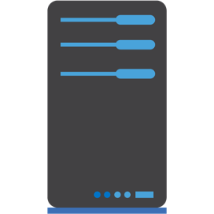

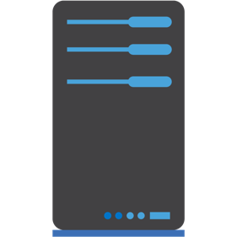

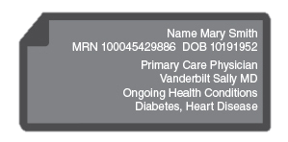
DNS as a Transport Mechanism
Exfiltration
Attacker registers a domain & sets up an authoritative DNS server on the Internet to act as the tunnel endpoint
Data to be sent from inside network is:
  Encrypted using public key
  Encoded into a-z, 0-9 and – using algorithm such as Base32, which allows up to 110 bytes to be encoded into an FQDN
  Divided into chunks of up to 63 characters (label limit)
  Sent as individual queries in format of <chunk>.domain
Queries can be sent direct (if allowed by firewall), via a network’s existing DNS servers or via proxies (e.g. request http://<chunk>.domain)
If sent via DNS the source address can be spoofed to make tracing harder
Attacker’s authoritative server receives encoded chunks, reassembles data, decodes & decrypts using private key
Attacker’s
DNS Server
KS93KDKSK344SD3434DS.100.foo.thief.com
kjhHJhUy7UjfryGF6rHDSFA.101.foo.thief.com
Data
INTERNET
ENTERPRISE
DNS server
KS93KDKSK344SD3434DS.100.foo.thief.com
kjhHJhUy7UjfryGF6rHDSFA.101.foo.thief.com
Infected
endpoint

Slide 37
DNS as a Transport Mechanism
Infiltration
Can be used to download a payload in a covert way for example.
TCP features can be imitated by encoding the chunks with additional data, such as Checksum & Packet Number
Data can be sent back in a variety of records, e.g.
  A - allowing 4 bytes (enough for codes, e.g. 1.1.1.200 = resend packet 200)
  AAAA - allowing 16 bytes
  MX record : 2 bytes + domain name (255 bytes)
  CNAME - allowing up to 110 bytes in Base32
  TXT - allowing N x 220 bytes in Base64 (up to RDATA limit of 64kB)
  NULL - allowing up to 256 bytes
Using TXT and NULL make transmission faster, at expense of easier detection

Slide 38



DGA – Domain Generation Algorithm
An algorithm producing Command & Control (C2) rendezvous points dynamically
For example: every day malware connects to time-based server FQDN: <month>-<day>-<year>.com
ie. on December 24, 2017 malware connects to 2017-12-24.com
DNS query: ajdhkbf.info
DNS Reply: NXdomain
DNS query: dnskasd.info
DNS Reply: NXdomain
Bot
DNS server
DNS query: akdjnfag.info
DNS Reply: 135.175.17.35
Example Family | Example Domain
DirCrypt | vlbqryjd.com
Bamital | b83ed4877eec1997fcc39b7ae590007a.info
CCleaner | ab6d54340c1a.com
Contact 135.175.17.35
Malicious Payload
Bot
C2 Server
IP 135.175.17.35

Slide 39
Lookalike Domain Detection
Detects from Newly Observed Domains (NOD), domain names that try to mimic popular domains (Alexa top-100) or strategic domains for phishing (e.g. banks) and spamming.
Detects domains that overlaps and/or have homograph n-grams,
e.g. letter ‘O’ and number ‘0’ are considered homographs.
Use distance analysis to detect the likelihood of lookalike attacks
Detects
  Letter replacement, example g00gle.com, gooogle.com, bankofthevvest.com, rn1cr0soft.com
  TLD change, example, walmart.cc
  other generic highly resembled domains, example: bankofAmericas.com
SOA record is analyzed and used for catching false positives.
apple.com >>> appIe.com (Arial)
apple.com >>> appIe.com (Cutive)

Slide 40
Legitimate DNS Tunneling
g63uar2ejiq5tlrkg3zezf2fkemc6pi88tz.er.spotify.com
a-0.19-b3000081.a010083.15e0.1d99.36d4.210.0.ic7arfsqqzf694fs8zf8nz2t9b.avts.mcafee.com
4rzjp8zy7i7vawluximoxrko1p2tn58gj0fjjj2g.p.03.s.sophosxl.net
p2.a22a43lt5rwfg.ihg5ki5i6q3cfn3n.191742.i1.ds.ipv6-exp.l.google.com
a1294.w20.akamai.net
dnn506yrbagrg.cloudfront.net
A98dc034c7781a941ebabac02262202668bbe918ea9fb5289cd2.r58.cf2.rackcdn.com

Slide 41
C2 over DNS over HTTPS (DoH)
Domain fronting
Domain fronting is a technique that masks the destination of a request by using different domains at various stages of the connection, allowing traffic to bypass certain filtering or detection systems.
curl 'https://google.com/resolve?name=malwareC2.com’
-H "Host: dns.google.com"
Unencrypted DNS lookup & TLS SNI: google.com
Encrypted HTTP host: dns.google.com
Requested Domain: malwareC2.com

Slide 42
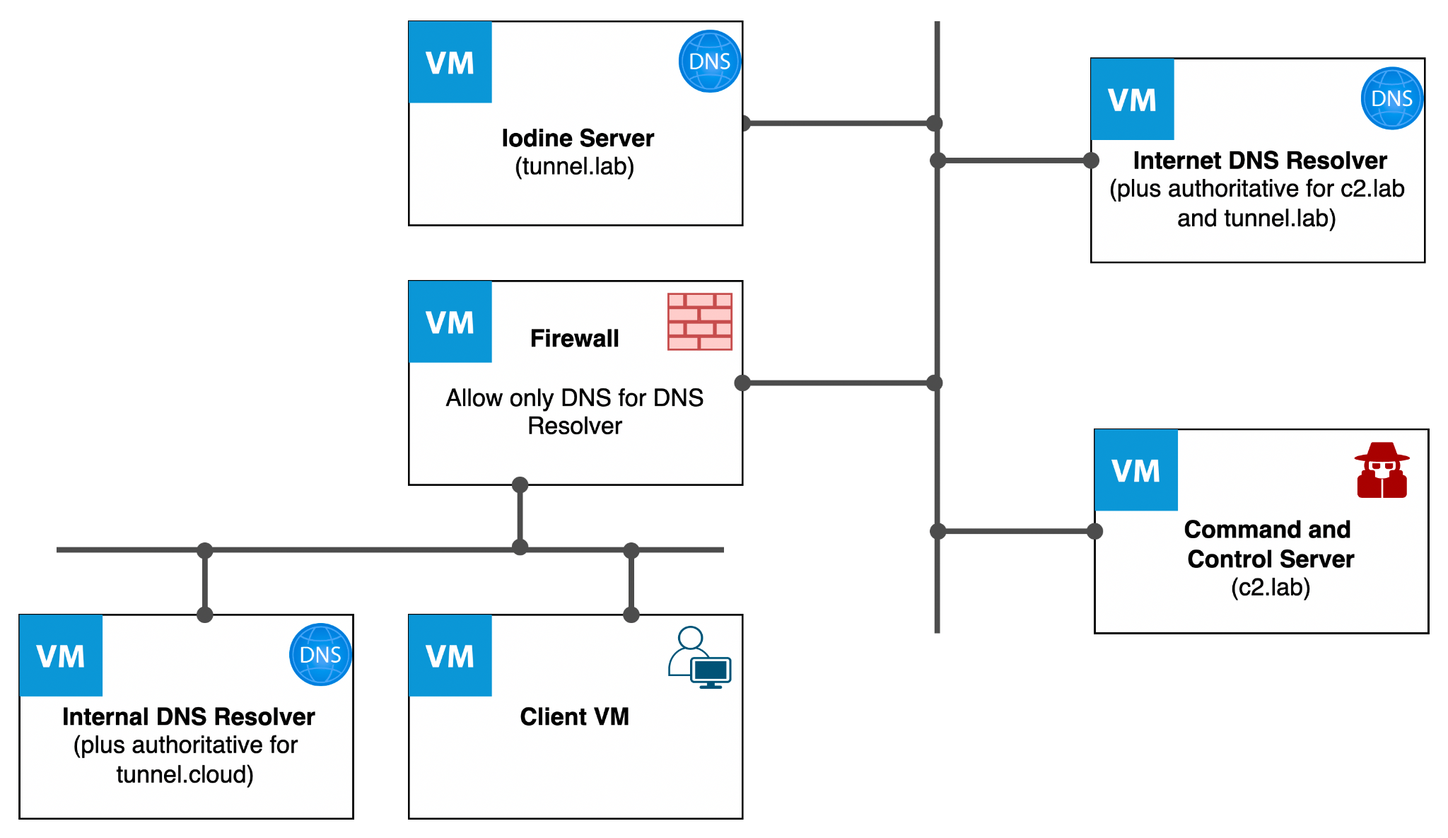
Lab: DNS Tunneling for bypassing filtering
Practical Exercise: DNS Tunneling with Iodine

Slide 43
Lab: Command and Control over DNS
Practical Exercise: DNS C2 with Sliver

Slide 44
DNS & CyberSecurity
Preventing communication over DNS
1
Stopping APTs/malware from using DNS
2
Defending DNS Infrastructure
3

Slide 45
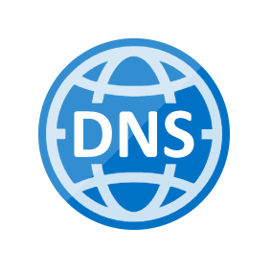
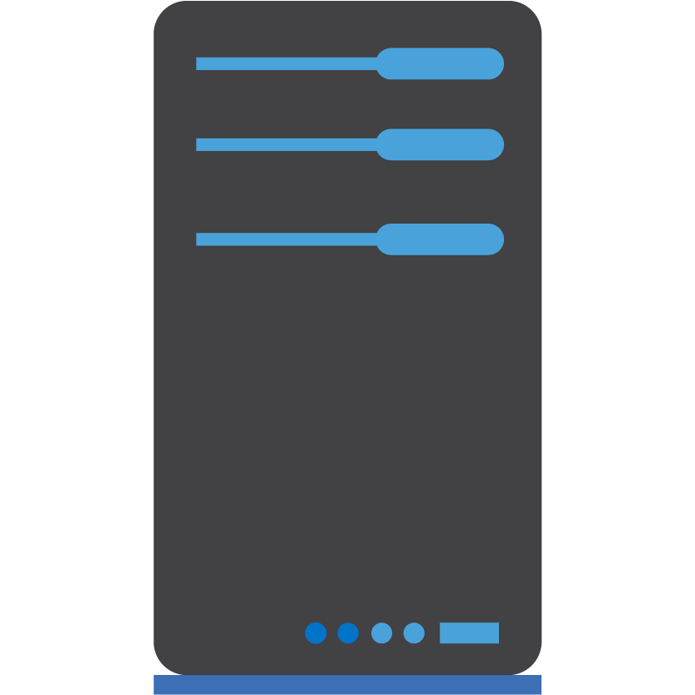
Detecting DNS Tunnels & Data Exfiltration
Traditional approach
Internet
  Use a firewall to rate limit UDP, slowing the speed at which data can be transferred but not preventing it from happening
  Analyze logs by hand / using a visualization tool to find evidence of tunneling / data exfiltration after it’s happened. Typically achieved by looking for abnormal query types (such as NULL), particular REGEXs and long queries all of the same length.
  Tunnel endpoints can then be blocked at the firewall level. Provides protection only if the attacker continues to use the same domain/server in the future.
  Manually configure security appliances (such as DDoS mitigation platforms) to block specific REGEXs, query types, long queries etc. Laborious process that risks blocking legitimate software such as anti-virus, that use DNS to check for new signatures, file hashes etc
Ineffective against APTs & software that can be configured to vary query length, query type etc. to avoid detection
INTERNET
ENTERPRISE
DNS
server
Client-side
tunnel program

Slide 46
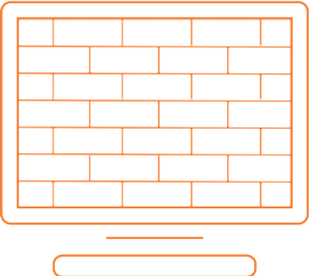
DNS Firewall
Like a firewall it implements a security policy (called RPZ – Response Policy Zone)
Has triggers:
  Queried domain name
  IP address in response
  IP address of querying client
And actions:
  Reject (NXdomain)
  Block (no data)
  Redirect
  Passthrough and log

Slide 47



Detecting DNS Tunnels & Data Exfiltration
DNS Firewall approach (vendor based solutions)
Signature
Reputation
Behavior
Use algorithms to detect and block all known DNS Tunneling tools
(in hardware, at line speed)
Use DNS Firewall to automatically block known tunnel, C2 and data exfiltration endpoints and newly registered domains with Vendor backed database
Use DNS heuristics to detect and block zero day data exfiltration, using real-time streaming analytics to mitigate against previously unseen code

Slide 48
DNS heuristics
Entropy
  Higher Entropy => more information transferred
  Legitimate DNS names often have dictionary words or something that looks meaningful.
  Encoded names have a higher entropy. DNS names that have high entropy can be an indicator of tunneling.
Lexical
  Analysis of individual characters in domain names
  non-letters (numbers or allowed special characters) character ratio
  hex /A-F/ character ratio
  vowel character ratio

Slide 49
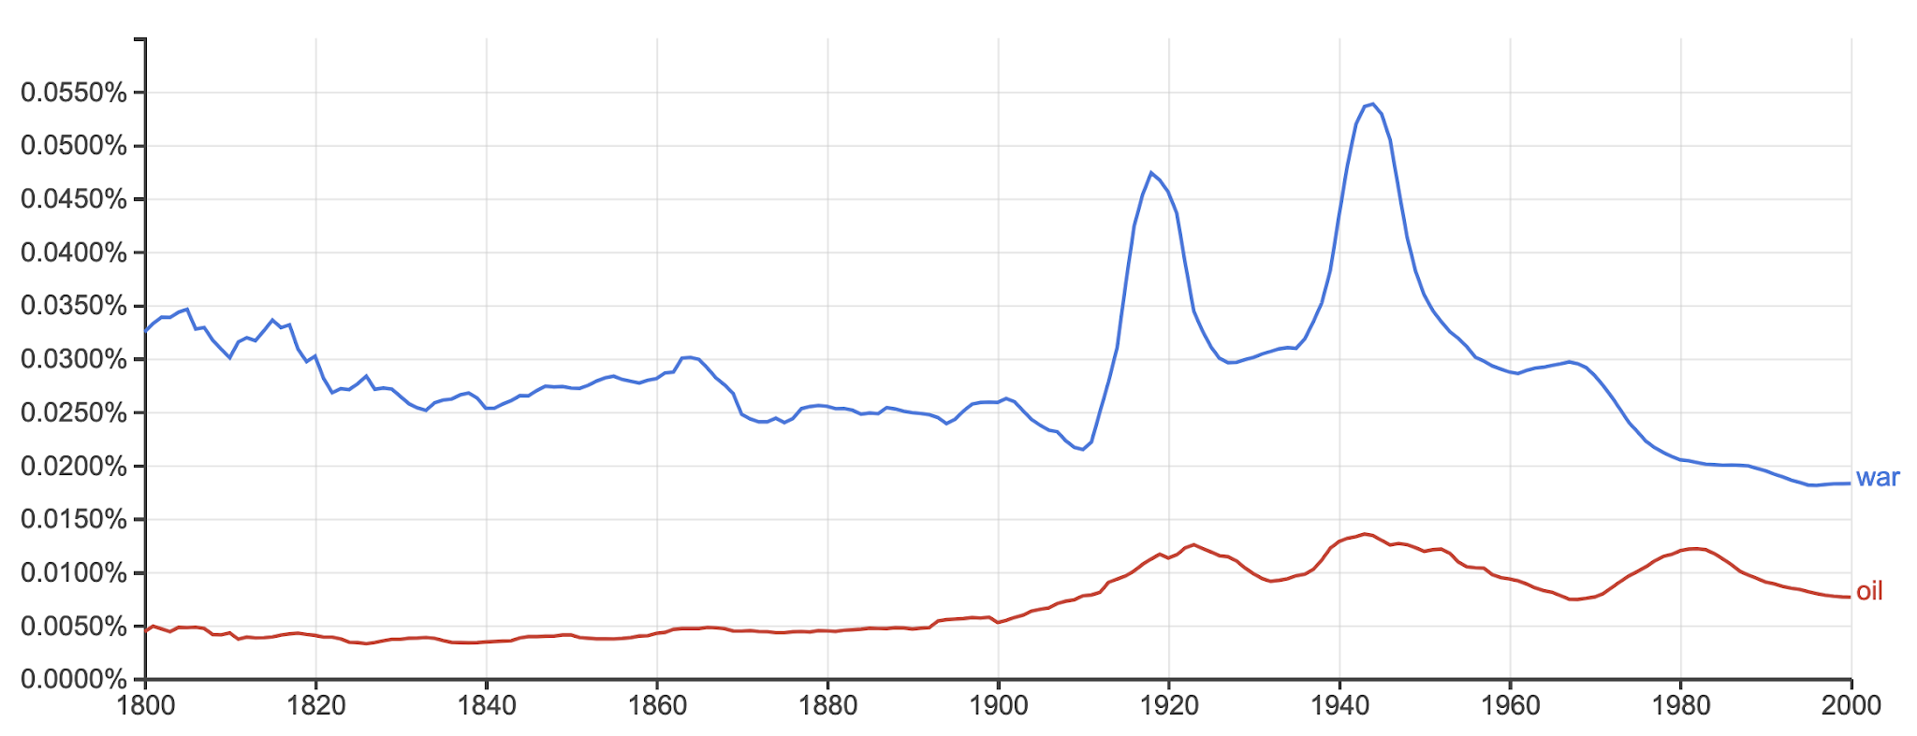
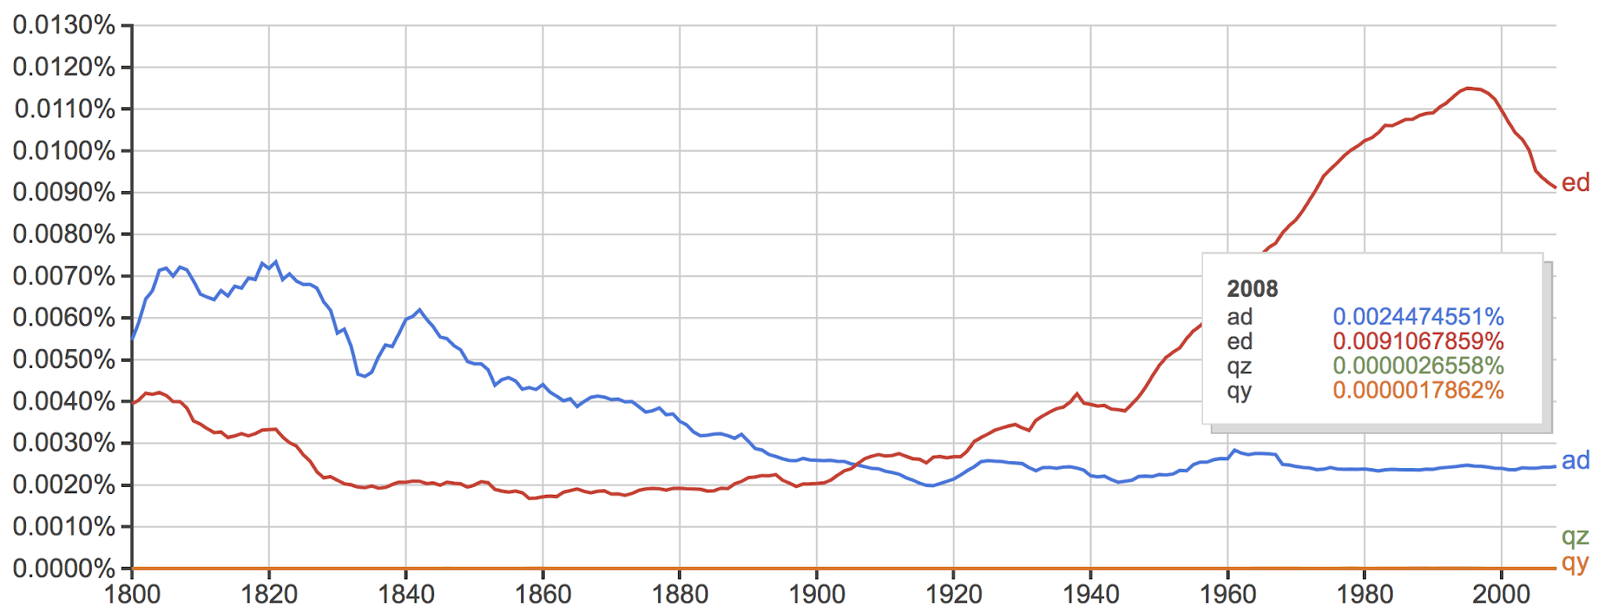
DNS heuristics
N-Gram
    Detects non human like domain names based on character distribution.
    Focus is on 2- and 3-gram (i.e. sequences of 2 or 3 characters, or bigram and trigram analysis).
Source: https://books.google.com/ngrams

Slide 50
DNS heuristics
    Gini index – how often a randomly chosen character from the domain name would be incorrectly labeled if it was randomly labeled according to the distribution of characters in the domain name
    Classification error – measure of the diversity of characters in the string
    Number of Labels – number of domain labels in an FQDN payload
    Frequency: how often are requests being sent to the same recipient (typically multiple requests to same recipient are not common and indicate malicious activity)
    Are the queries being repeated at precise intervals?
    Size Higher payload size => more information transferred

Slide 51
DNS & CyberSecurity
Preventing communication over DNS
1
Stopping APTs/malware from using DNS
2
Defending DNS Infrastructure
3

Slide 52
Type of DNS attacks
DNS reflection/DrDoS attacks
Using third-party DNS servers (mostly open resolvers) to propagate a DoS or DDoS attack
DNS amplification
Using a specially crafted query to create an amplified response to flood the victim with traffic
TCP/UDP/ICMP floods
Denial of service on layer 3 or 4 by bringing a network or service down by flooding it with large amounts of traffic
NXDomain attack
Attacks that flood DNS server with requests for non-existent domains, causing it to send NXDomain (non-existent domain) responses
Phantom domain attack
Attacks where a DNS resolver is forced to resolve multiple non-existent domains, causing it to consume resources while waiting for responses
DNS-based exploits
Attacks that exploit bugs or vulnerabilities in the DNS software
DNS cache poisoning
Corruption of DNS server cache data with a rogue domain or IP
Causing the server to crash by sending malformed DNS packets and queries
Protocol anomalies
Reconnaissance
Attempts by hackers to get information on the network environment before launching a DDoS or other type of attack via DNS queries or Zone Transfers
DNS tunneling
Tunneling of another protocol through DNS port 53 for malware insertion and/or data exfiltration
DNS hijacking
Modifying the DNS record settings to point to a rogue DNS server or domain
DNS-specific Exploits
Volumetric/DDoS Attacks

Slide 53
Lab: DNS Reconnaissance
Practical Exercise: Reconnaissance of a domain

Slide 54
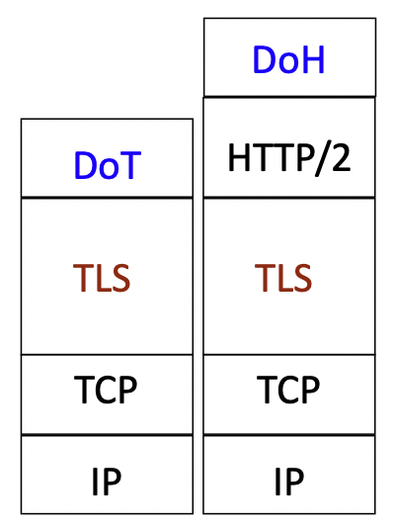
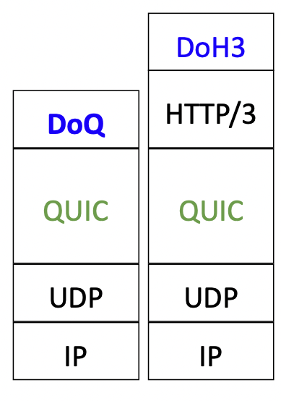
Improvements of DNS
TLS1.3
TLS1.3
DNS Transport mechanisms
  DNS over TLS (DoT): use DNS over TLS encryption on TCP port 853 (RFC 7858)
  DNS over HTTPs (DoH/DoH3) : use HTTP2 or 3 for encrypting requests
  DNS-over-QUIC (DoQ): use QUIC for data transport and encryption (UDP port 853 (also port used for DNS over DTLS)
DNS Data authentication:
  DNSSEC: use specific DNS records to ensure that the answer given is the authorized one
Notes:
❯ curl 'https://dns.google.com/resolve?name=eu.nomad.airbus.com' -H "Host: dns.google.com"
{"Status":0,"TC":false,"RD":true,"RA":true,"AD":false,"CD":false,"Question":[{"name":"eu.nomad.airbus.com.","type":1}],"Answer":[{"name":"eu.nomad.airbus.com.","type":5,"TTL":60,"data":"eu-nomad.dyn.airbus.com."},{"name":"eu-nomad.dyn.airbus.com.","type":1,"TTL":60,"data":"193.56.36.114"}],"Comment":"Response from 193.56.36.45."}

Slide 55
Comparing DoT/DoQ and DoH/DoH3
DoT | DoH
RFC 7858 | RFC 8484
New Port 853 | Port 443 (HTTPS)
Traffic can easily be blocked and not open normally by default in enterprise | Traffic looks like every other encrypted web traffic
No API capabilities | API capabilities
 | Built-in browser support

Slide 56
DNSSEC
The original design of the Domain Name System (DNS) did not include security and allowed false DNS data to be returned.
This required trust that the DNS answers were authentic and not modified.
Domain Name System Security Extensions (DNSSEC) is a set of extensions to DNS that provide DNS clients via a digital signature (resolvers) origin authentication of DNS data.
By validating the digital signature, a DNS resolver can check if the information is identical to the data published by the zone owner and served on an authoritative DNS server and thereby mitigate, such as ‘man-in-the-middle attacks’
DNSSEC doesn’t provide confidentiality of data, and the responses are authenticated but not encrypted.

Slide 57
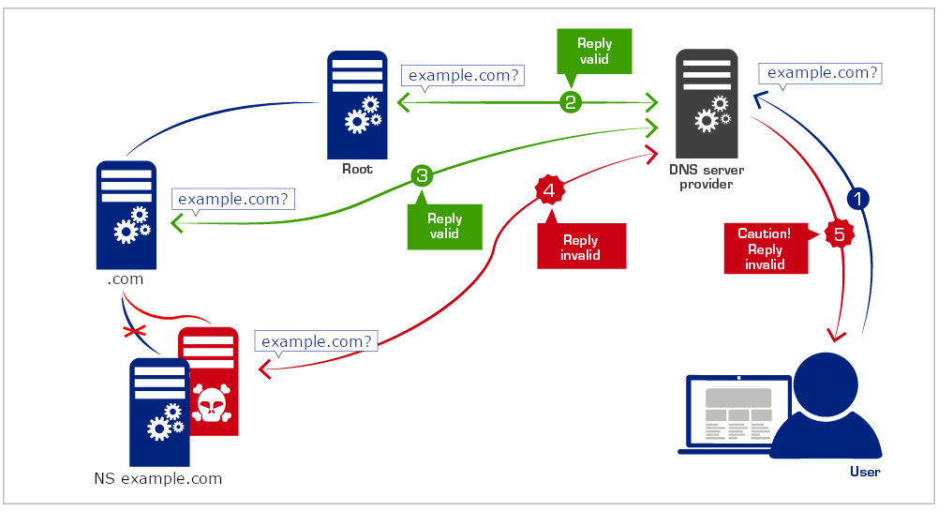
DNSSEC

Slide 58
Ressources
DNS RFCs
An Illustrated Guide to the Kaminsky DNS Vulnerability
DNS for Rocket Scientists

Slide 59
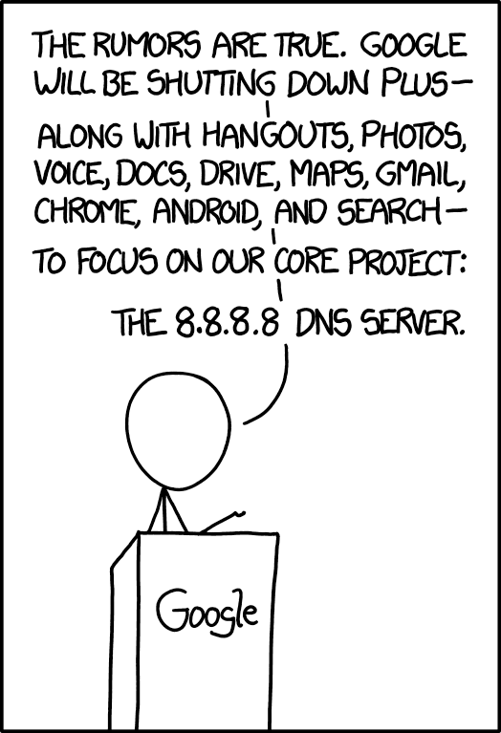
❯ dig -x 8.8.8.8 +short
dns.google.
❯ dig txt dns.google. +short
"https://xkcd.com/1361/"
"v=spf1 -all"

